Slide 1

Notes:
Hello everyone! My name is Emily and I am here to tell you all about KSS Air Ambulance Charity – your local Air Ambulance Charity. I am now going to show you a video which is going to give you a little bit more information about KSS.

Slide 2

KS3
Welcome
to the KSS
Mission Badge!

Slide 4
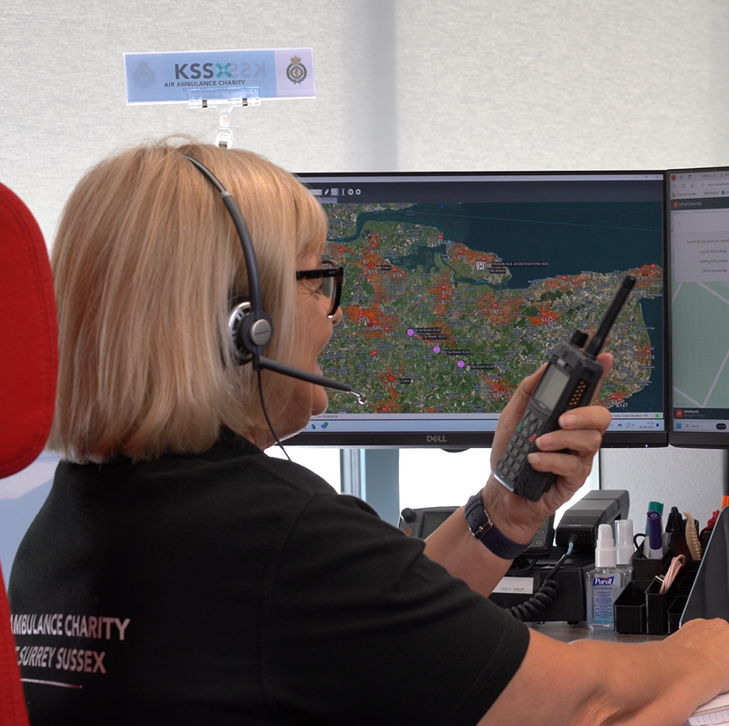
Section 1
KS3
What to do in
an emergency

Slide 5
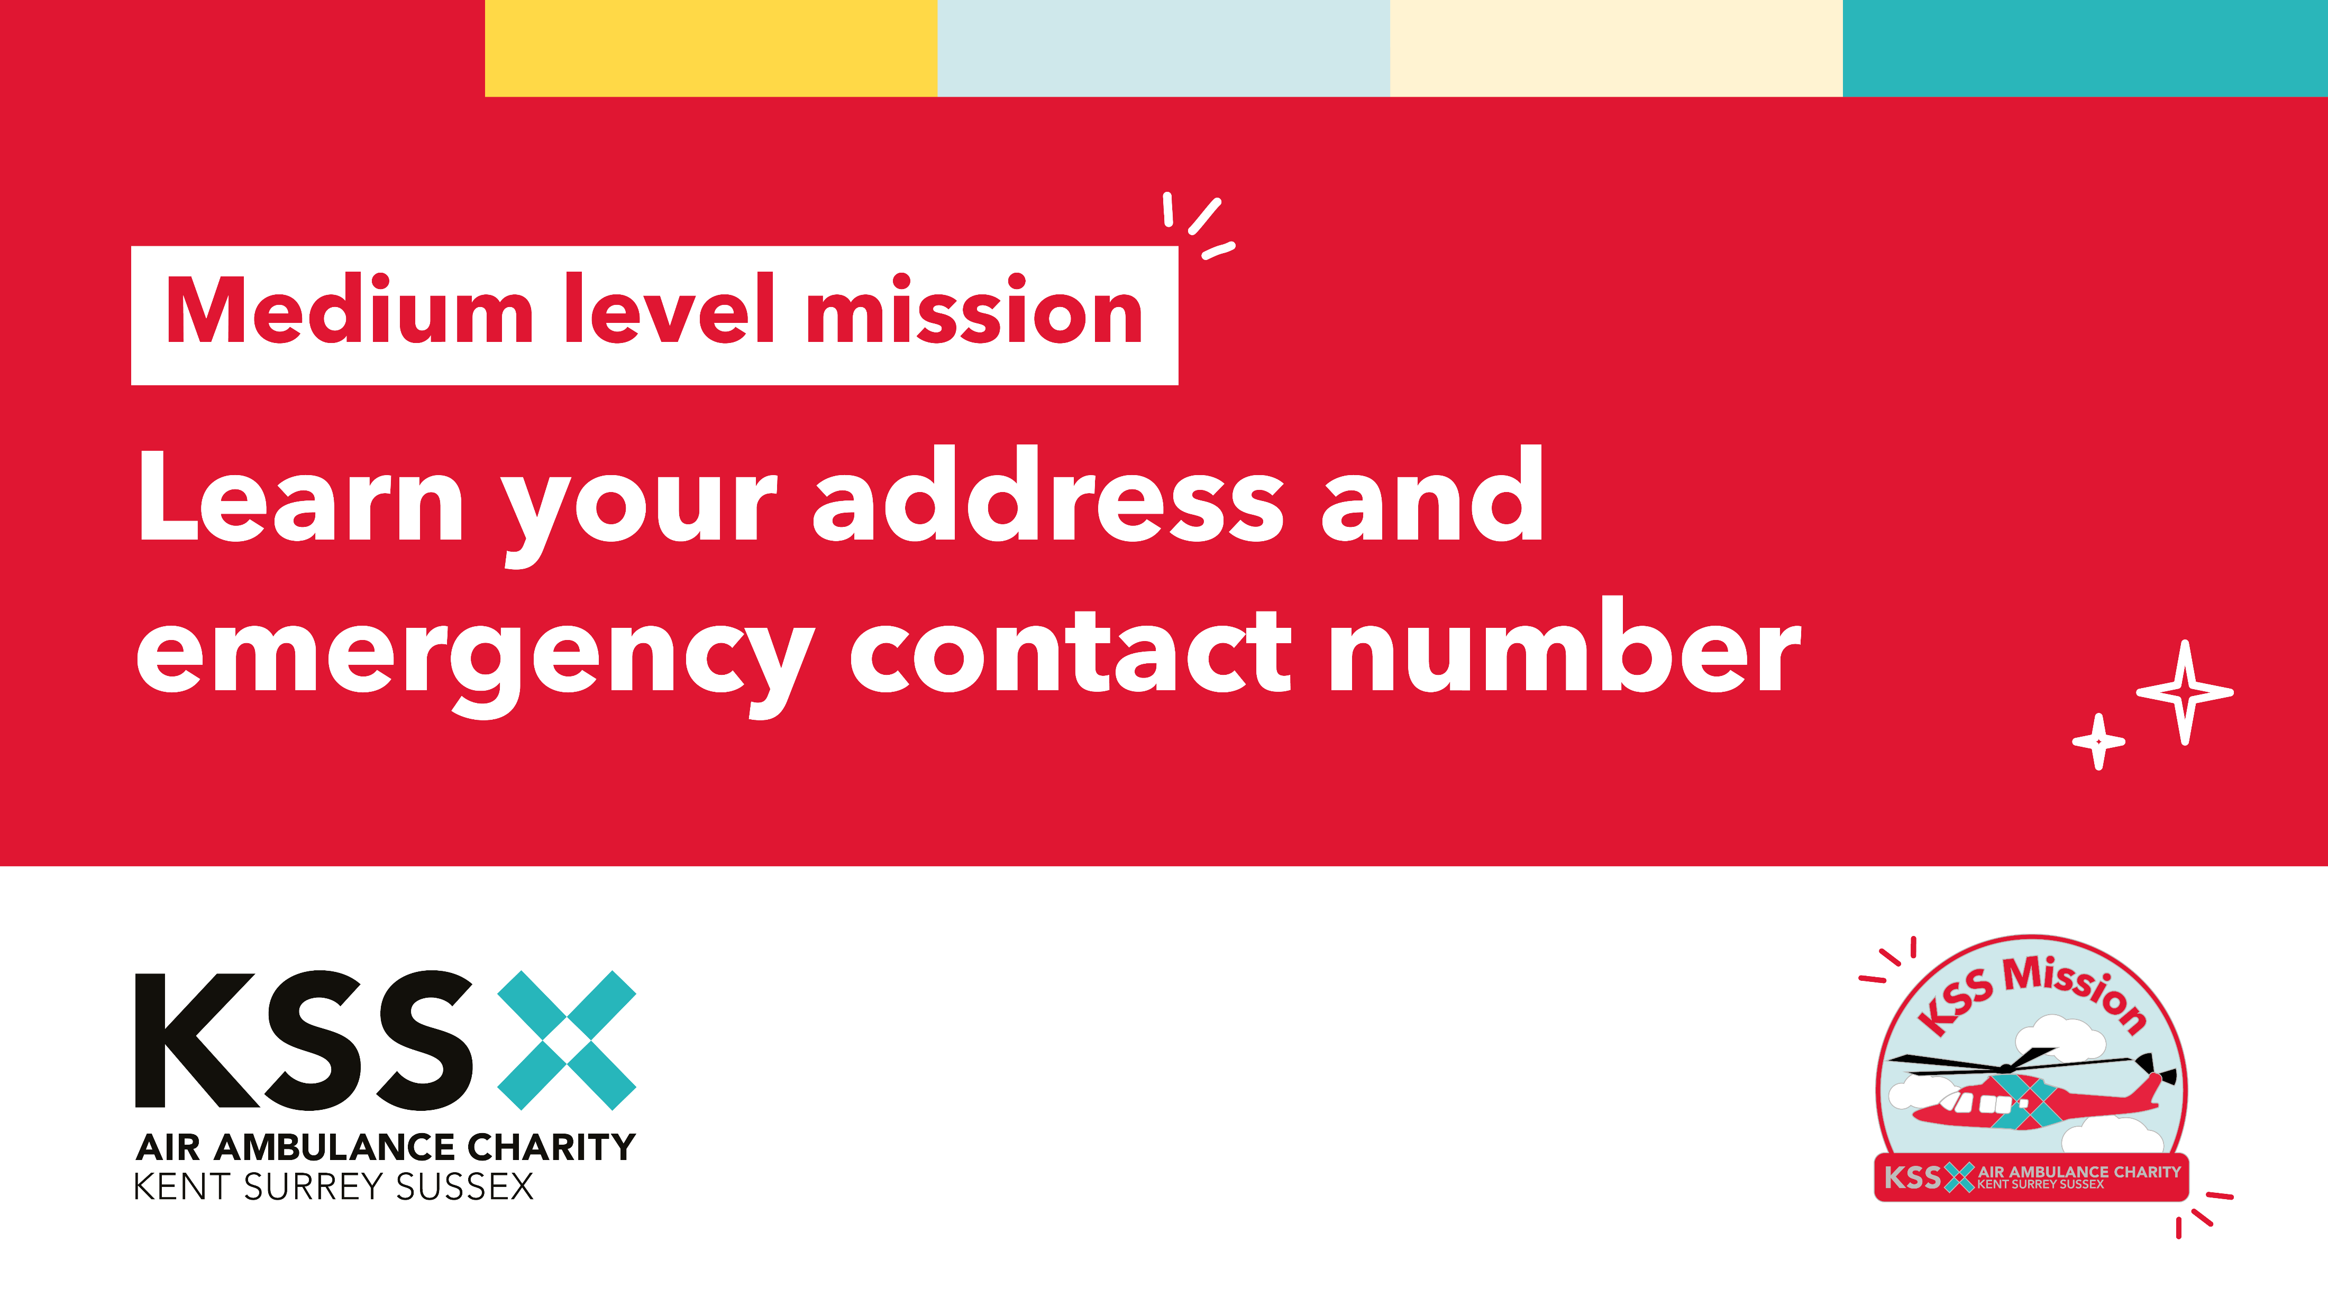
Section 1
KS3
What to do in an emergency

Slide 6
Section 1
KS3
What to do in an emergency
For this mission we’d like you to practice giving
information clearly in an emergency.
In partners:
One is the call handler
One is the 999 caller reporting an emergency.
The call handler asks: “What’s happened?” and “What’s the address?”
Then take turns playing both roles so everyone practises giving clear information.

Slide 7
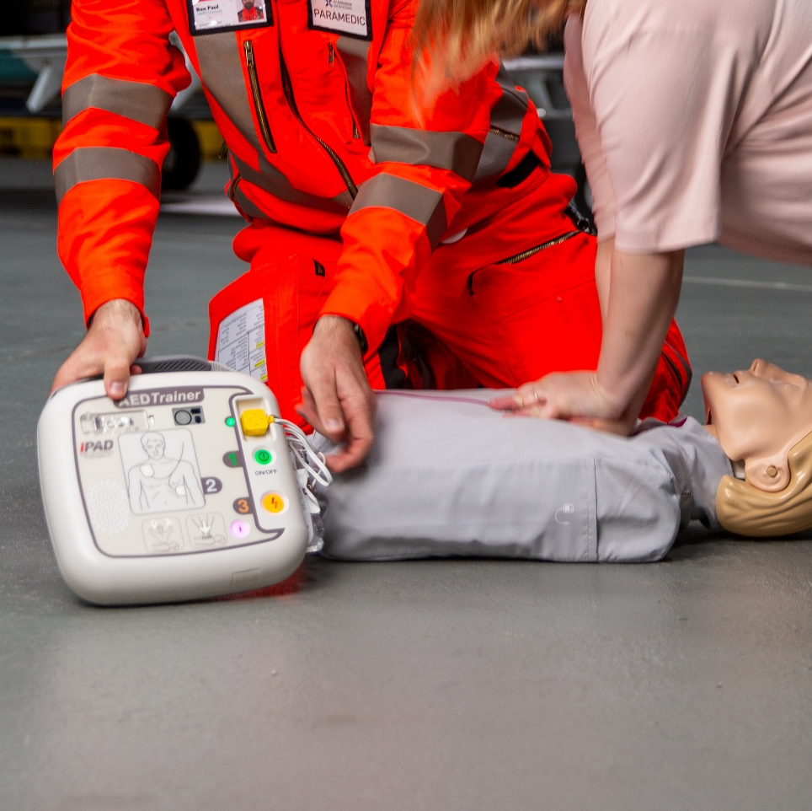
Section 1
KS3
What to do in an emergency
Visit defibfinder.uk and look up the nearest defibrillator to your school. Are they available day and night? How many are close by? Are there gaps in coverage where more could be placed?
Do you have a defibrillator at your school or nearby? If you can, visit so you know what the cabinet looks like. Some are locked and need a code from a 999-call handler; others are open all the time.
Notes:
A defibrillator gives a controlled jolt of energy that can help restart the heart during a cardiac arrest. Around 25 people every day in the Southeast experience an out-of-hospital cardiac arrest.
CPR and defibrillation can more than double someone’s chance of survival (You’ll learn more
about this in Section 3: Become a Lifesaver with Our Crew.) Yet defibrillators are used by bystanders in fewer than 10% of cases.
Your mission is to help change that.

Slide 8
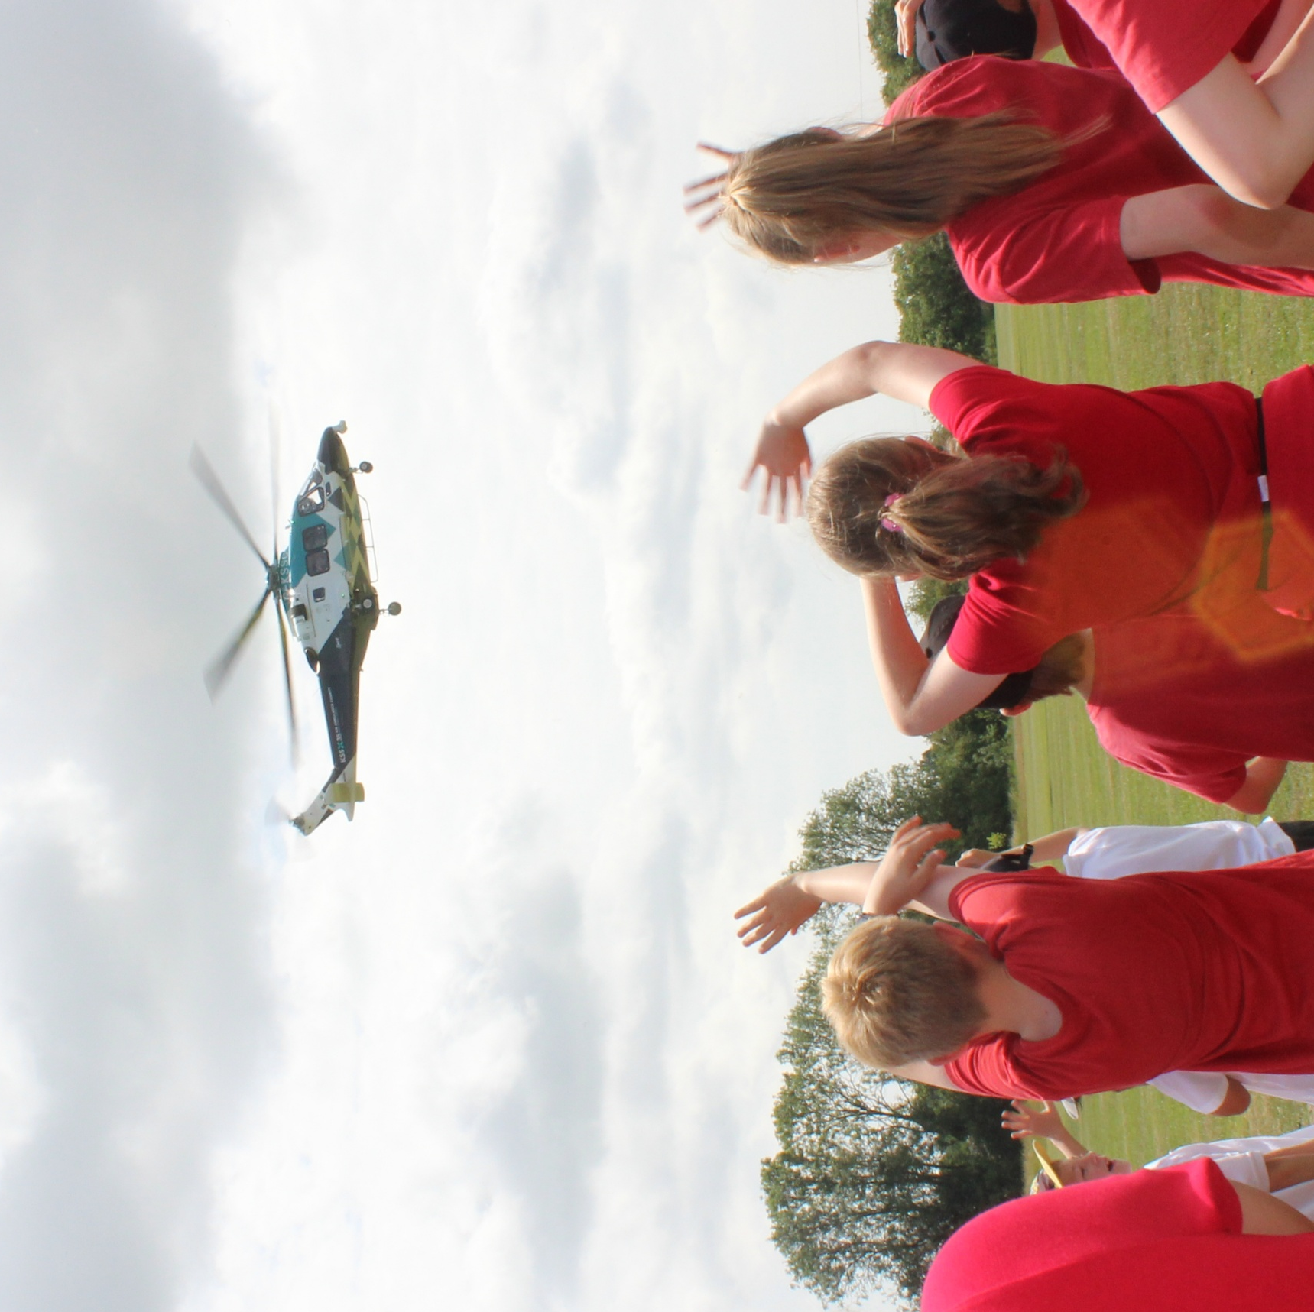
Section 5
KS3
Become a KSS Champion!

Slide 9
Section 5
KS3
Become a KSS Champion!
Raising money is essential to keeping our lifesaving service operating. That’s why this mission is a key part of earning your badge - without fundraising and awareness, we can’t be there when every second counts.
We’d love you as a class to plan a fundraising event.
Do some research and decide what type of fundraising event you’d like to host. This could be a Wear Red Instead Day, bake sale, talent show, quiz, a sporty challenge or maybe you have another fabulous idea!
Spread the word! Design invitations and posters that are colourful and clear with all the important details. Display these around your school to let everyone know about your fundraising event.

Slide 10
Section 5
KS3
Become a KSS Champion!
Get your venue ready!
Let everyone know that you’re fundraising for KSS and decorate with ballons, bunting, stickers, posters and display some of our key information. Contact us at community@aakss.org.uk and we can send some fundraising resources to you.
Celebrate your success!
Well done you’ve raised money and awareness for KSS! You’ve helped keep your local air ambulance flying. Make sure to take pictures of your fundraising and let us know how much you have raised by emailing community@aakss.org.uk

Slide 11
Section 5
KS3
Become a KSS Champion!
Want to take your fundraising further? Sharing your story helps inspire even more people to support KSS. Choose one of the below to spread the news about your event!
Write a letter to your local community leader
and invite them to your event.
Write a press release about your event.
Send the event details to your local Parish newsletter.
Share it on your school’s social media or
a local Facebook group (with permission).

