Slide 1

Hello everyone!
Notes:
​

Slide 2

KS2
Welcome
to the KSS
Mission Badge!

Slide 4
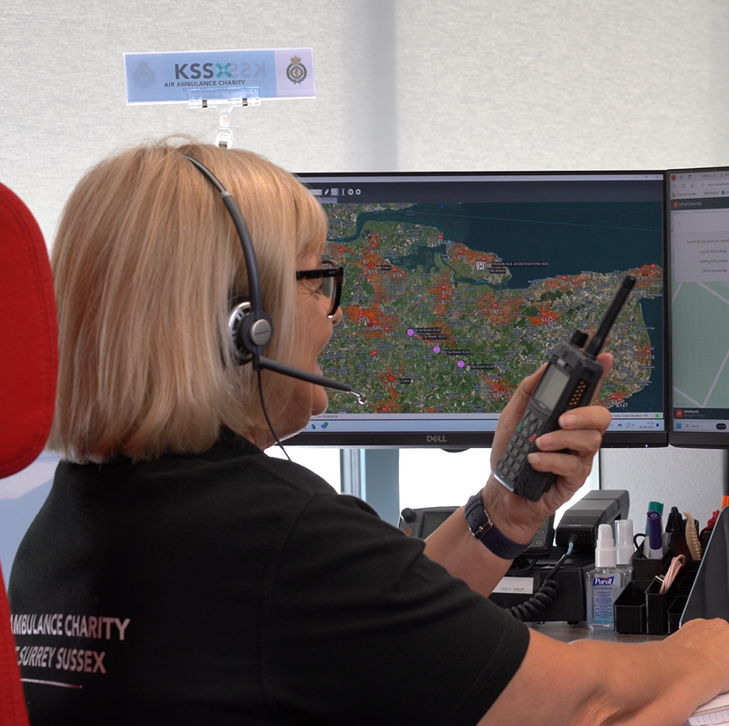
Section 1
KS2
What to do in
an emergency

Slide 5
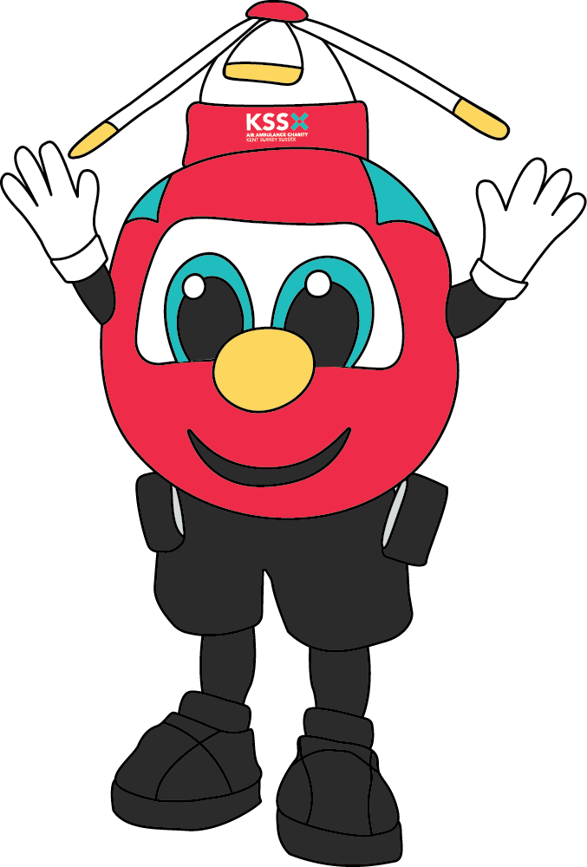
Section 1
KS2
What to do in an emergency
Knowing what an emergency is – and what to do if you’re ever in one – can help save a life.
Shout “Call 999 if you think it is an emergency”

Slide 6
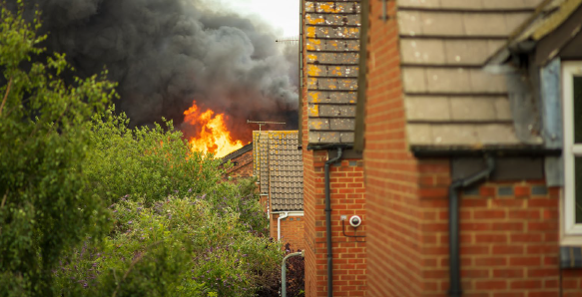

Slide 7
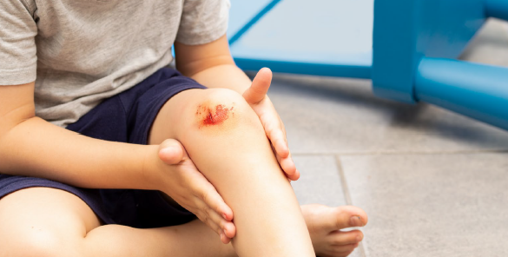

Slide 8
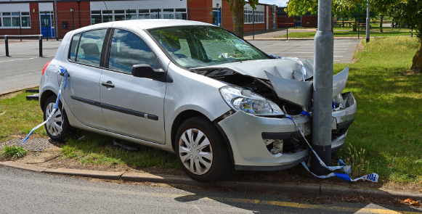

Slide 9
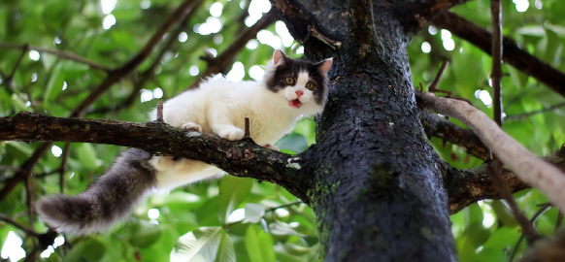

Slide 10


Slide 11
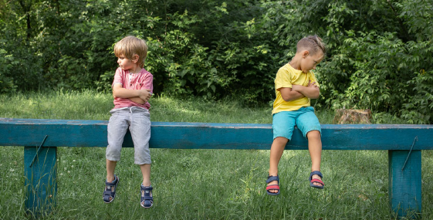

Slide 12
Section 1
KS2
What to do in an emergency
Q1: What do you think the job of a 999-call handler is?
Q2: When you call 999 what do you think is important to remember when speaking to the call handler?

Slide 13
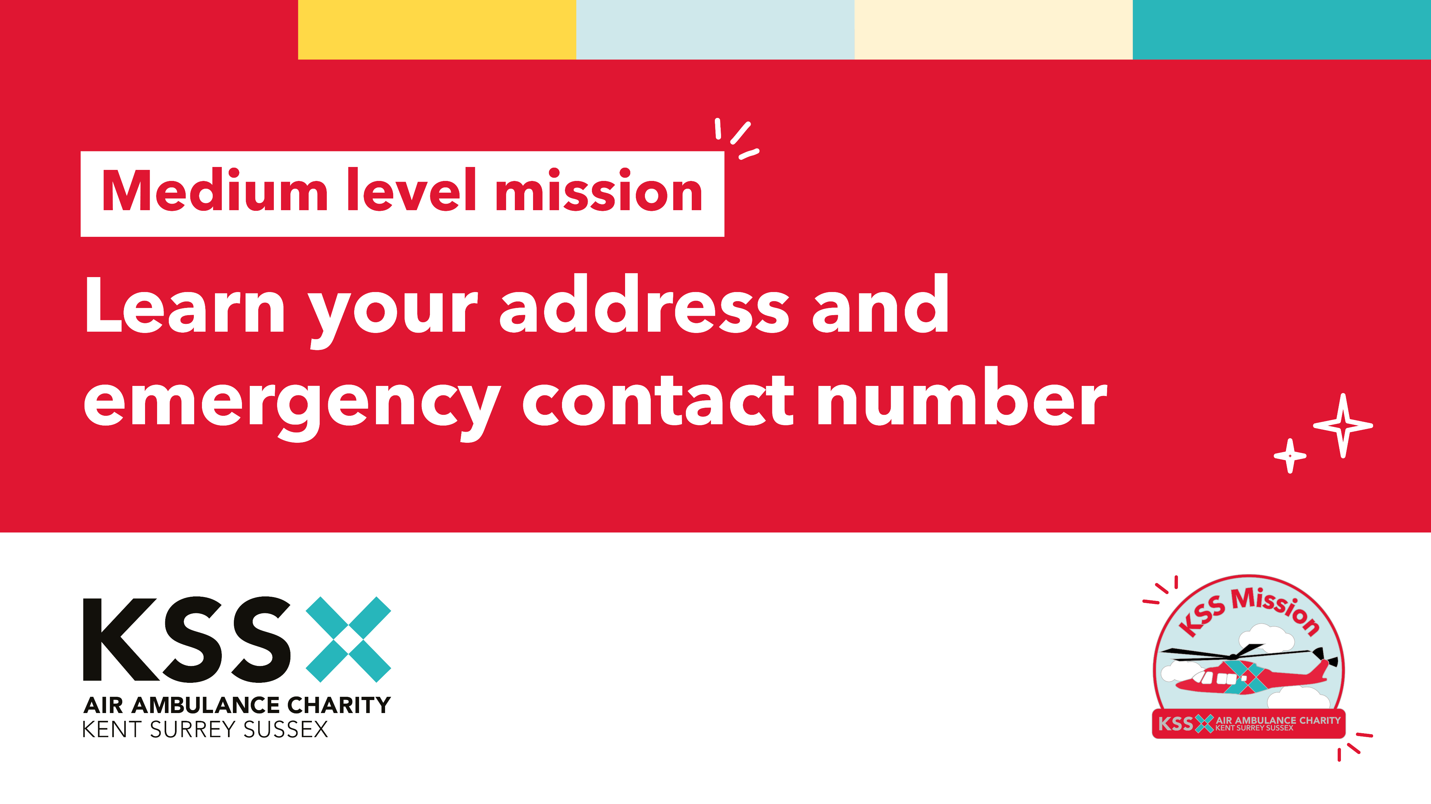
Section 1
KS2
What to do in an emergency

Slide 14
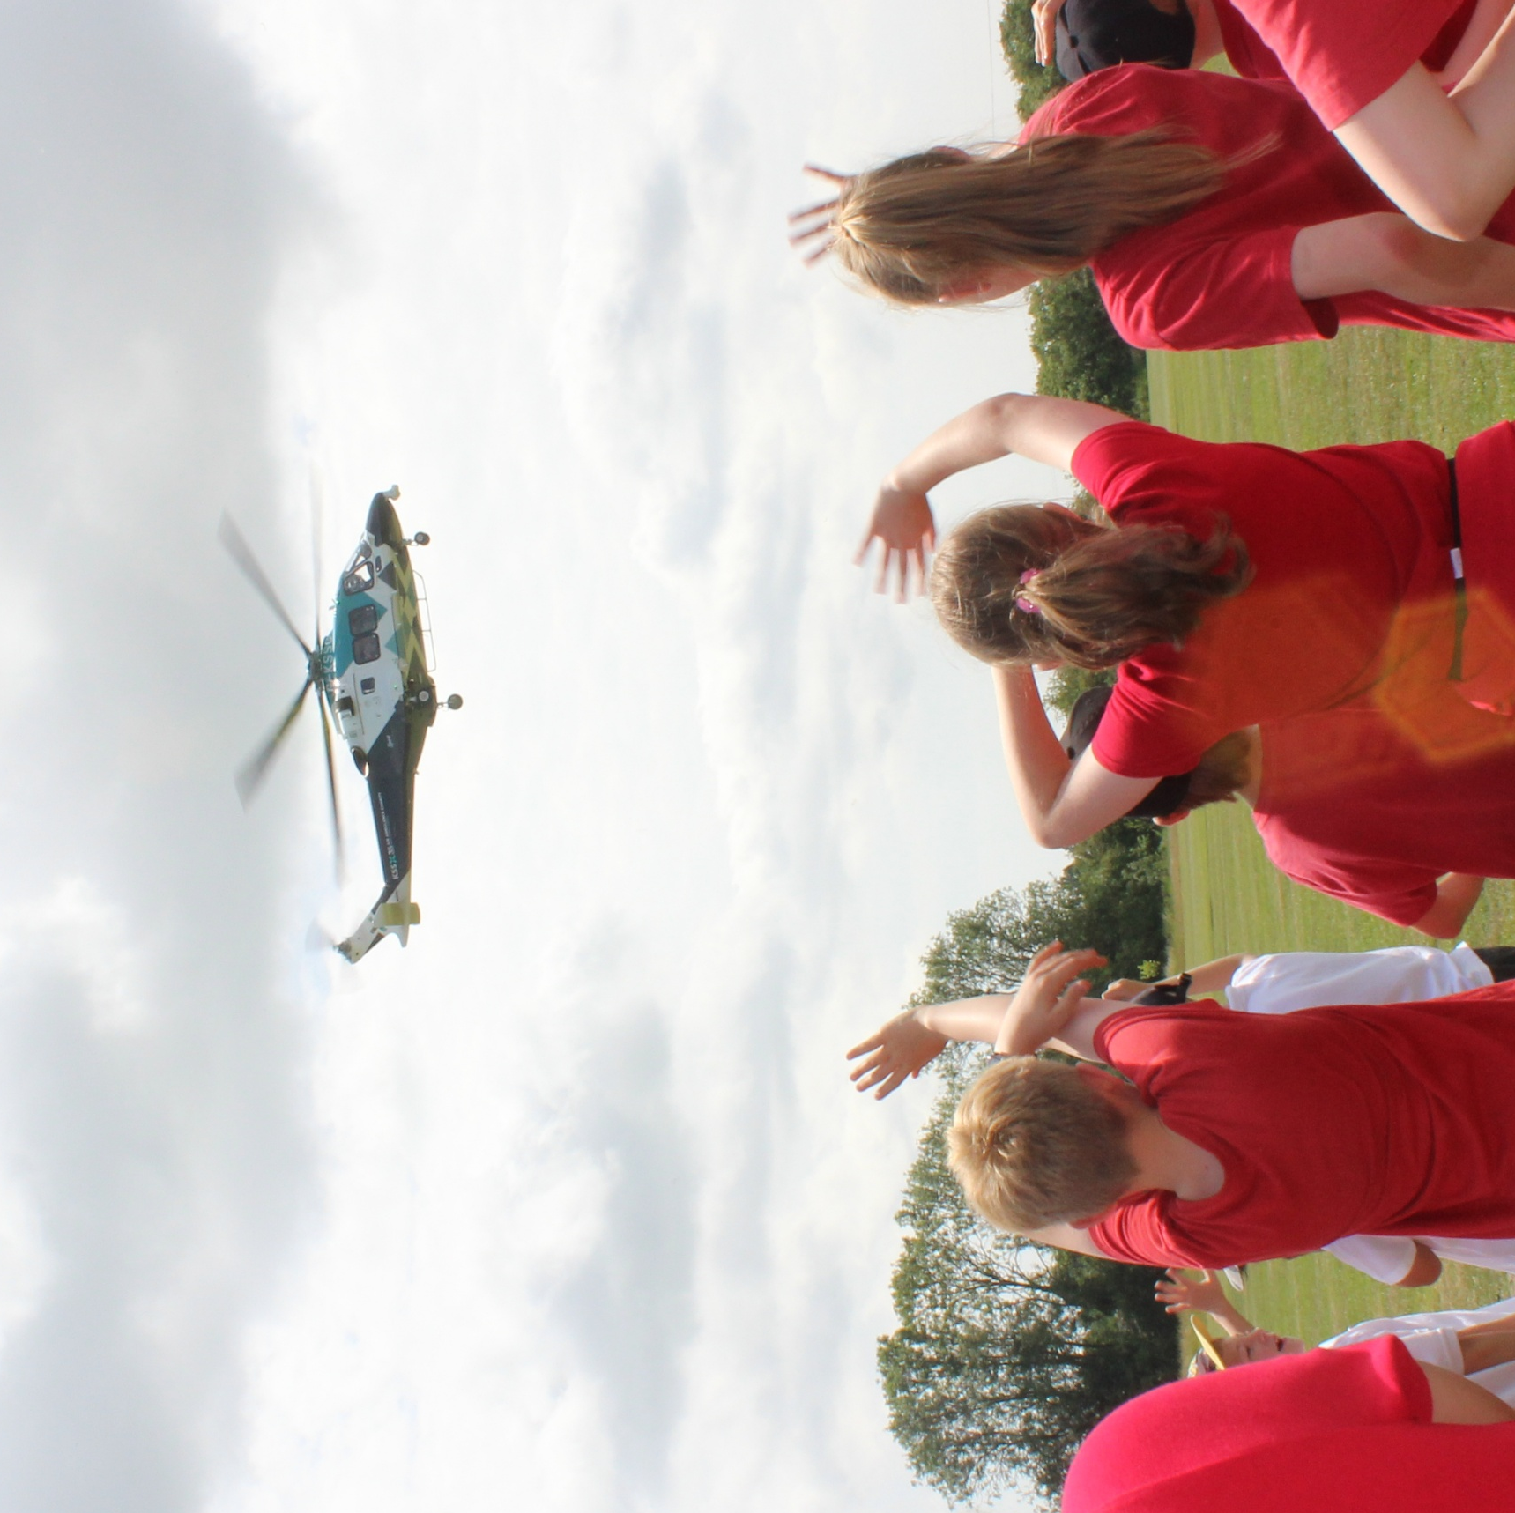
Section 5
KS2
Become a KSS Champion!

Slide 15
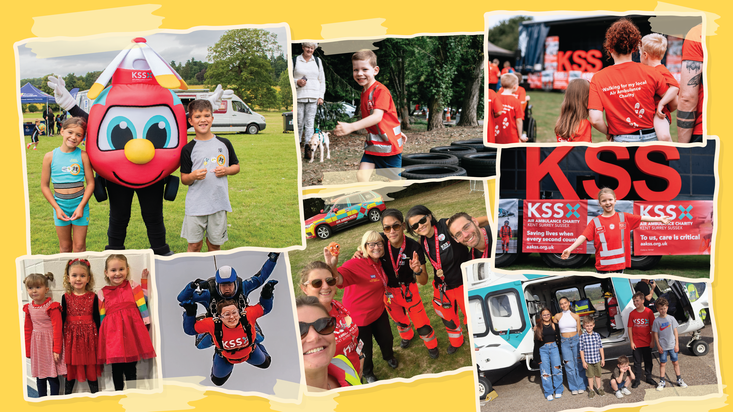
So many people help us!
Notes:
Raising money is very important to keeping our lifesaving service operating. That’s why this mission is a key part of earning your badge - without fundraising and awareness, we can’t be there when every second counts.

Slide 16
Section 5
KS2
Become a KSS Champion!
Fundraising Challenge:
1) Spread the Word
Research some facts about KSS and work with a partner or on your own to create an awareness poster all about KSS. Could you display these around your school and let everyone know about our lifesaving work?
2) Plan a fundraiser!
Or as a class plan a future fundraising event. Some ideas to get you
started could be: Take part in a bake sale, danceathon or sponsored challenge. Or maybe you have some fantastic fundraising ideas of your own!

