Slide 1

Hello everyone!
Notes:
​

Slide 2

KS1
Welcome
to the KSS
Mission Badge!

Slide 4
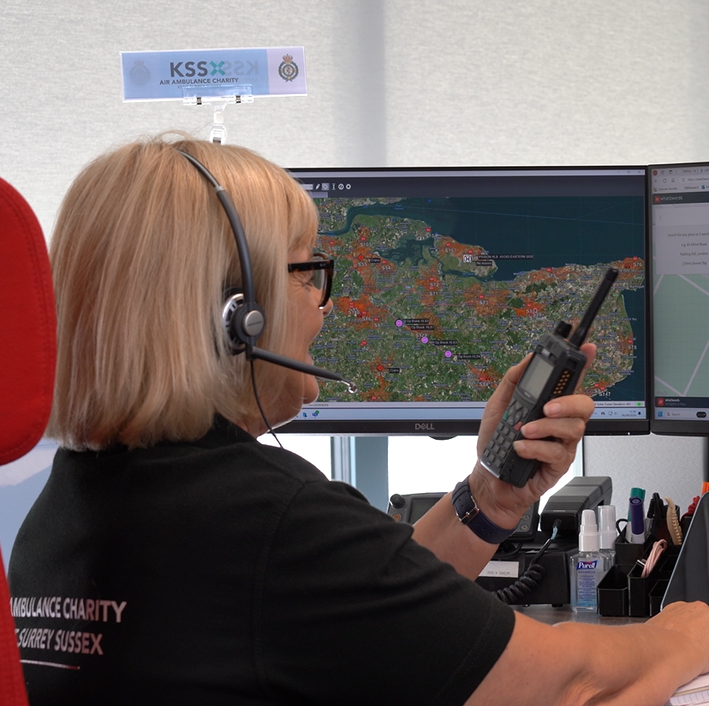
Section 1
KS1
What to do in
an emergency

Slide 5
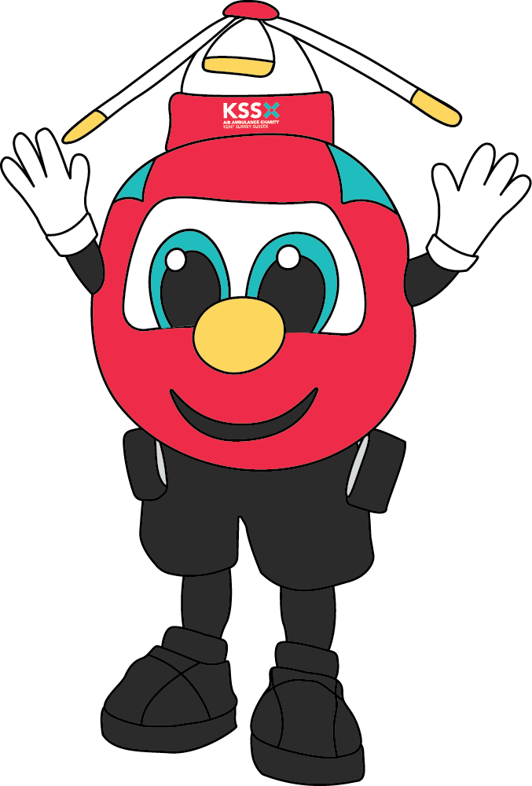
Section 1
KS1
What to do in an emergency
Knowing what an emergency is – and what to do if you’re ever in one – can help save a life.
Shout “Call 999 if you think it is an emergency”

Slide 6
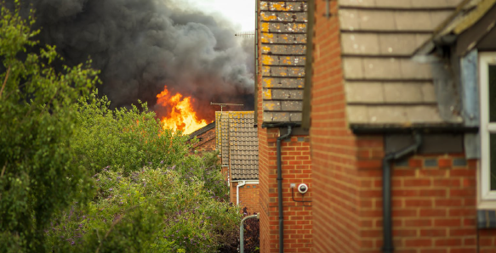

Slide 7
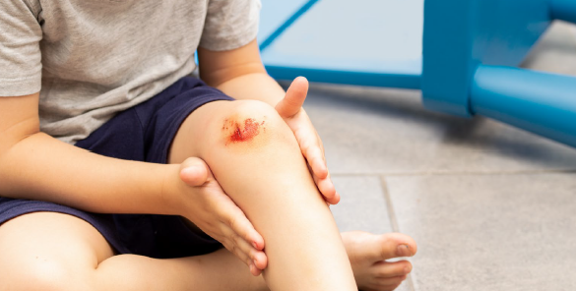

Slide 8
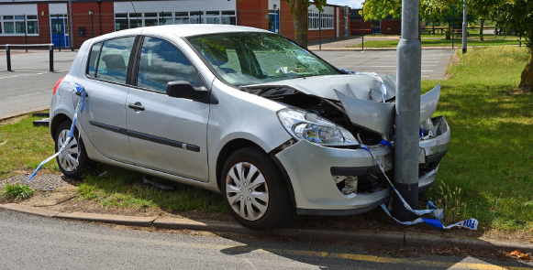

Slide 9
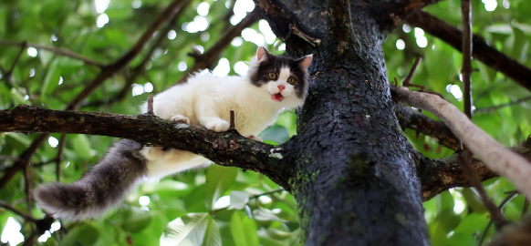

Slide 10


Slide 11
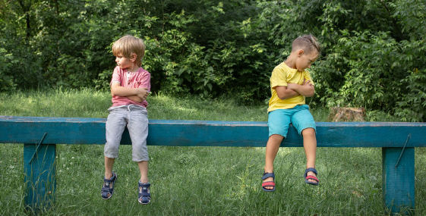

Slide 12
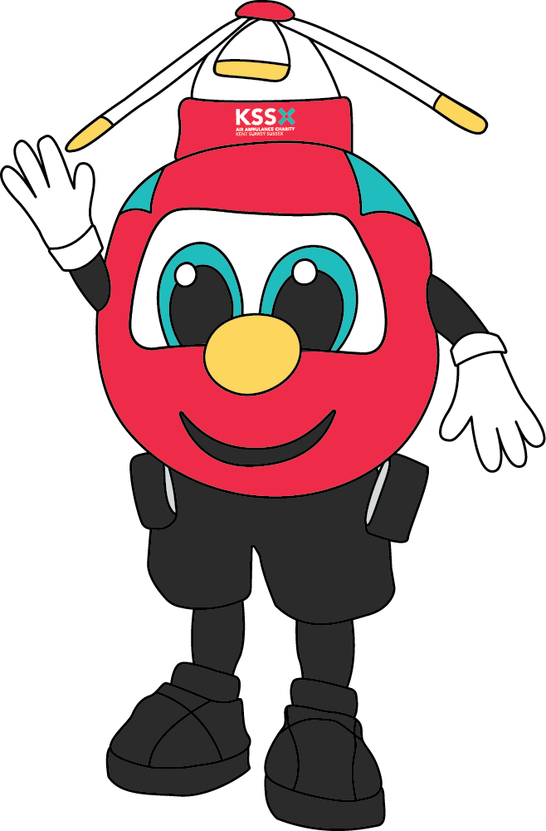
Section 1
KS1
What to do in an emergency
If you ever found yourself in an emergency, it’s important to know exactly what to do!
Who could help you if you were on
your own in an emergency?
When you call 999, what do you think you
might need to say on the phone?
What do you think the call handler may ask you?

Slide 13
Section 1
KS1
What to do in an emergency
Play our letter delivery game!
Sit in a circle and your teacher pretends to deliver a letter and says,
“I am going to deliver a letter to someone who lives at….”
If you recognise the address as your own, put your
hand up, run around the circle and sit back down.
Play this
game as many
times as you
would like!

Slide 14
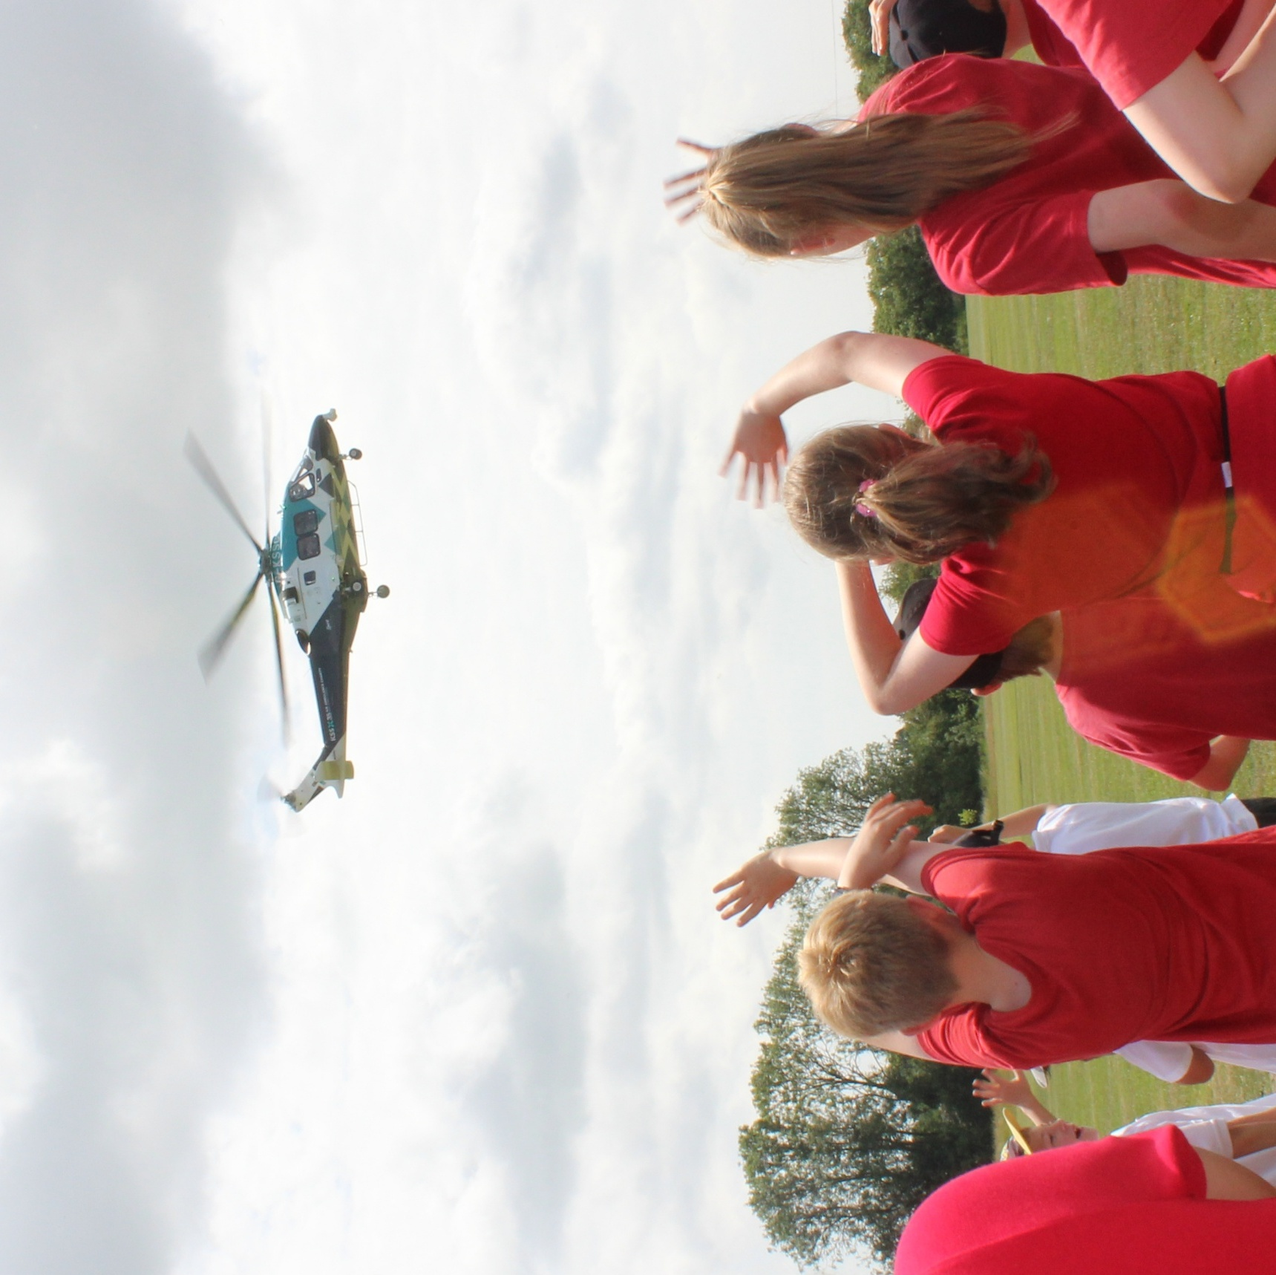
Section 5
KS1
Become a KSS Champion!

Slide 15
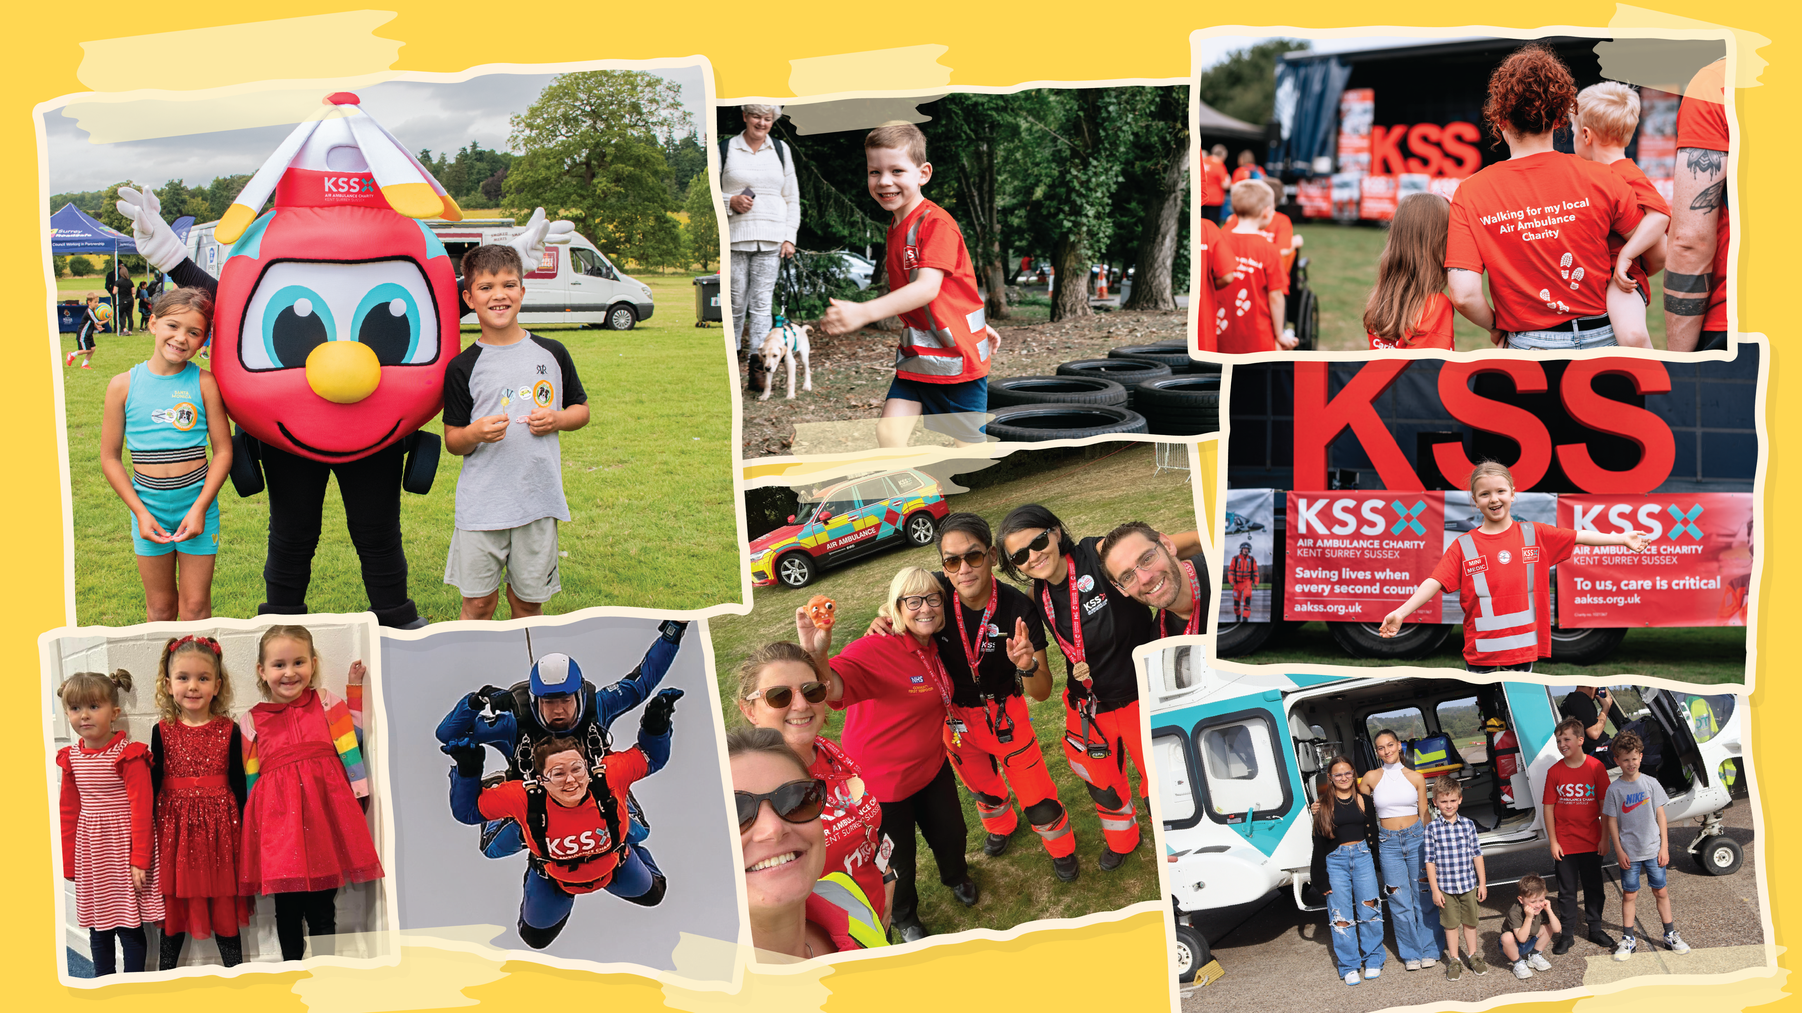
So many people help us!
Notes:
Raising money is very important to keeping our lifesaving service operating. That’s why this mission is a key part of earning your badge - without fundraising and awareness, we can’t be there when every second counts.

Slide 16
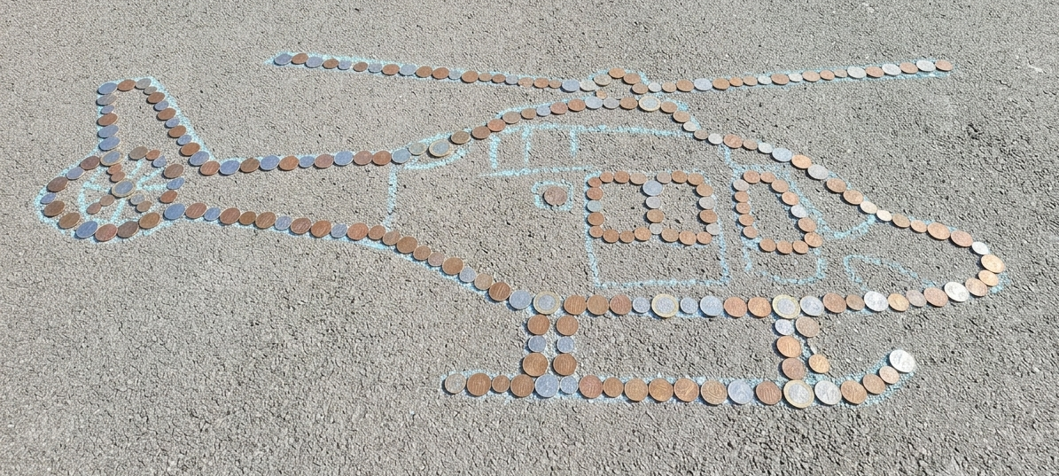
Section 5
KS1
Become a KSS Champion!
Fundraising Challenge:
Class challenge
1) Take home one of our collection boxes
Once you have decorated your collection box, take it home and
encourage those you live with to give you their loose change.
Who can
collect the
most coins?
2) Create a Helicopter Coin Trail
Once you’ve brought back your coins, can you create while you donate?
An oldie but a goodie! Bring in your loose change from home and help your group create a 3D
helicopter. Use our templates or why not create a massive helicopter, how big can you make it?

